Slide 1
Agenda
Day1 | Fundamentals of Machine Learning: Introduction to Machine Learning and its Applications, Machine Learning Python Tools. Simple machine learning application. Data Preprocessing: Data Sets, Classic Data Sets, What is Data Preprocessing ?, Need of Data Preprocessing , Major Tasks in Data Preprocessing , Preprocessing the Data in Python : Importing Libraries , Splitting Data into Training and Testing Data, Data Preprocessing Steps: Importing the useful packages , Defining Sample Data , Applying Preprocessing Techniques like Scaling , Standardization , Normalization , Mean Removal and Labelling the Data
Day2 | Types of Machine Learning Algorithms Bayesian Learning: Bayes Theorem and Concept Learning, ML and LS error Hypothesis, Naïve Bayes Classifier, Bayesian belief networks, EM Algorithm
Day 3 | Instance Based Learning: Introduction, K-nearest neighbor learning, locally weighted regression, radial basis function, cased based reasoning. Reinforced Learning: Introduction, Learning Task, Q Learning

Slide 2
Day 1
Fundamentals of Machine Learning Data Preprocessing

Slide 3
1.Fundamentals of Machine Learning
Why Machine Learning
What is Machine Learning ?
How Does ML Works
ML Applications
ML Use Cases
Understanding ML using Analogy
AI , ML and DL
Machine Learning Python Tools.
Simple machine learning application.

Slide 4
Why Machine Learning ?

Slide 5
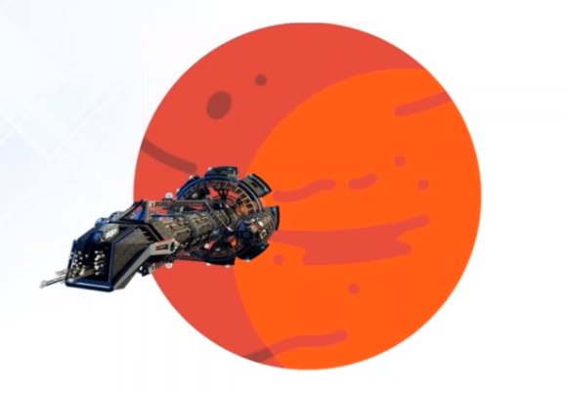
a. Why Machine Learning ?
Navigation on Mars or Deep ocean Where no humans are present

Slide 6
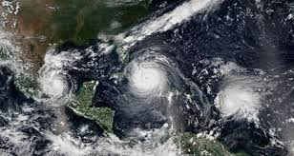
a. Why Machine Learning ?
Analyzing huge sensor data and predicting the outcome eg: in Forecasting Systems is not possible by manual calculations

Slide 7

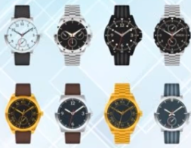
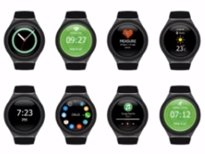
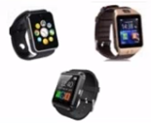
Recommending a product to buyers e.g. used by amazon , flipkart , Snapdeal etc., is not possible by manual calculations
Purchase History of a Customer
Search list of a Customer
a. Why Machine Learning ?

Slide 8
b. What is Machine Learning ?

Slide 9

b. What is Machine Learning ?
Is a type of Artificial Intelligence that provides computers with the ability to learn without being explicitly programmed.
Machine Learning is a concept which allows the machine to learn from examples and experience, and that too without being explicitly programmed.
So instead of you writing the code, what you do is you feed data to the generic algorithm, and the algorithm/ machine builds the logic based on the given data.
ML enables the computers or the machines to make data-driven decisions rather than being explicitly programmed for carrying out a certain task. These programs or algorithms are designed in a way that they learn and improve over time when are exposed to new data.

Slide 10
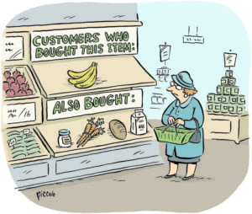

b. What is Machine Learning?
Have you ever shopped online? So while checking for a product, did you noticed when it recommends for a product similar to what you are looking for? or did you noticed “the person bought this product also bought this” combination of products. How are they doing this recommendation? This is machine learning.
Did you ever get a call from any bank or finance company asking you to take a loan or an insurance policy? What do you think, do they call everyone? No, they call only a few selected customers who they think will purchase their product. How do they select? This is target marketing and can be applied using Clustering. This is machine learning.

Slide 11
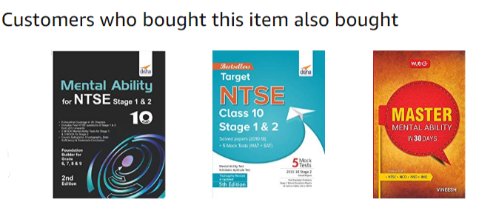
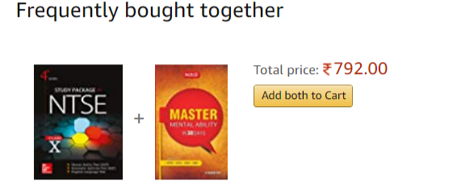
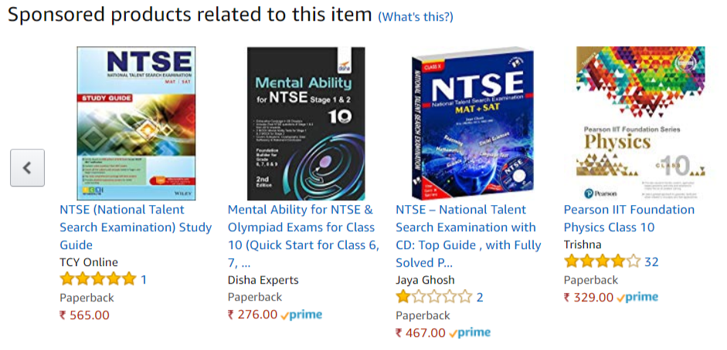
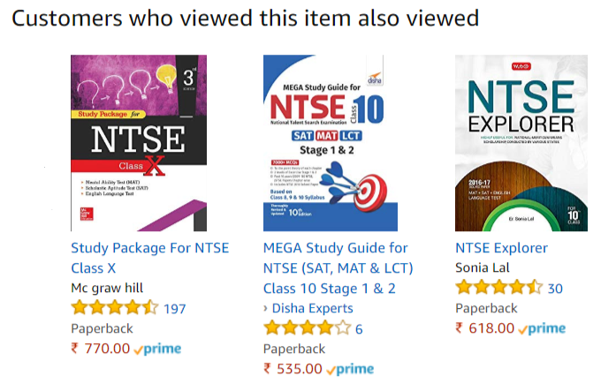

Slide 12
c. How does Machine Learning Works ?

Slide 13
c. How does Machine Learning Work?
Machine Learning algorithm is trained using a training data set to create a model. When new input data is introduced to the ML algorithm, it makes a prediction on the basis of the model.
The prediction is evaluated for accuracy and if the accuracy is acceptable, the Machine Learning algorithm is deployed. If the accuracy is not acceptable, the Machine Learning algorithm is trained again and again with an augmented training data set.
This is just a very high-level example as there are many factors and other steps involved.

Slide 14
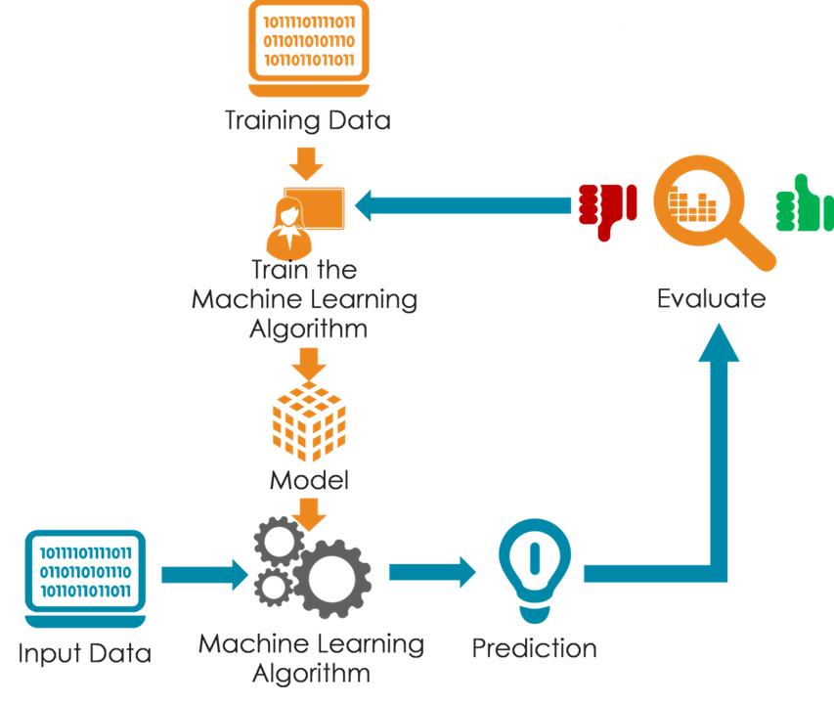

Slide 15


Slide 16
d. Machine Learning Applications
Virtual Personal Assistants
Videos Surveillance
Social Media Services
Email Spam and Malware Filtering
Online Customer Support
Search Engine Result Refining
Product Recommendations
Online Fraud Detection

Slide 17
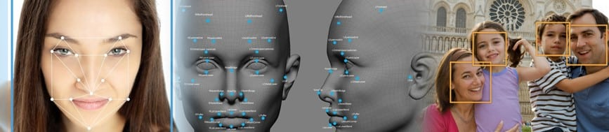
d. Machine Learning Use Cases
Face Detection.

Slide 18


Slide 19
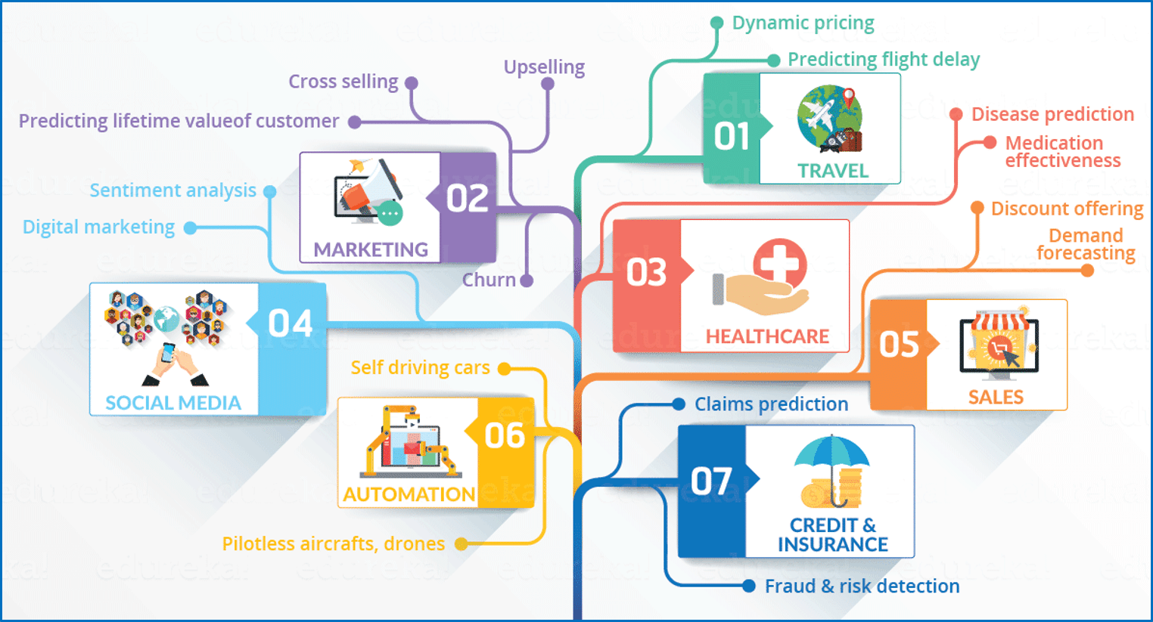

Slide 20
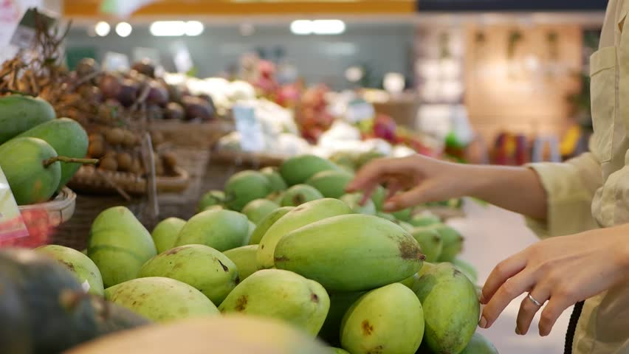
e. Understanding Machine Learning with an Analogy
As a Human: Let’s suppose one day you went for shopping mangoes. The vendor had a cart full of mangoes from where you could handpick the mangoes, get them weighed and pay according to the rate fixed per Kg.
Task: How will you choose the best mangoes?

Slide 21
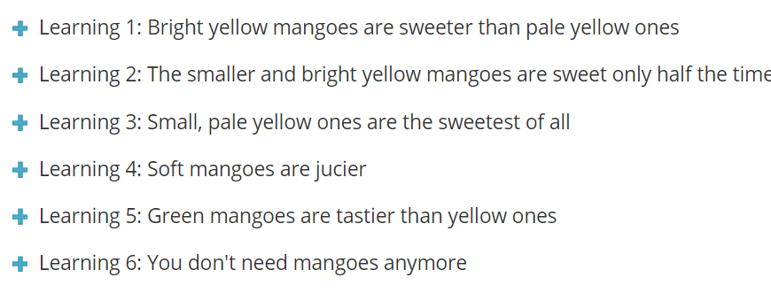
Set of learning,
Given below is set of learning, human gains from his experience of shopping mangoes, you can drill it down to have a further look at it in detail. Go through it once, you will relate it to machine learning very easily.

Slide 22
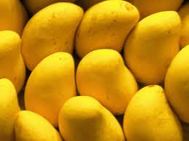
Learning 1
Experience 1:
You were informed that bright and yellow mangoes are sweeter than pale and yellow ones.
So you make a simple rule: pick only from the bright yellow mangoes. You check the colour of the mangoes, pick the bright yellow ones, pay up, and return home. Right?

Slide 23
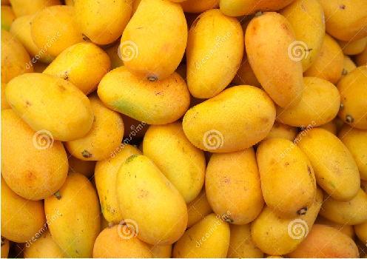
Learning2
Experience 2:
Now when you went home and tasted the mangoes, some of them were not sweet as you thought. You are worried as your wisdom was insufficient. You concluded that when it comes shopping mangoes, you have to look for more than just the colours.
After a lot of pondering and tasting different types of mangoes,you concluded that the bigger and bright yellow mangoes are guaranteed to be sweet, while the smaller, bright yellow mangoes are sweet only half the time (i.e. if you bought 100 bright yellow mangoes (50 will be big in size and rest 50 will be small), then the 50 big mangoes will all be sweet, while out of the 50 small ones, only 25 mangoes will turn out to be sweet). You will then update your rule about the mango shopping and from next time you will keep this in mind.

Slide 24
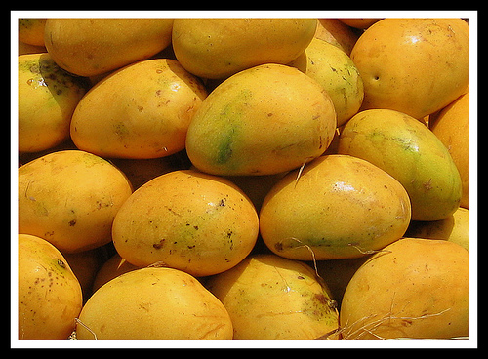
Learning 3
Experience 3: Tragedy: Next time at the market, you see that your favorite vendor has gone out of town. You decide to buy from a different vendor, who supplies mangoes grown from a different part of the country. Now, you realize that the rule which you had learnt (that big, bright yellow mangoes are the sweetest) is no longer applicable. You have to learn from scratch. You taste a mango of each kind from this vendor and realize that the small, pale yellow ones are in fact the sweetest of all.

Slide 25
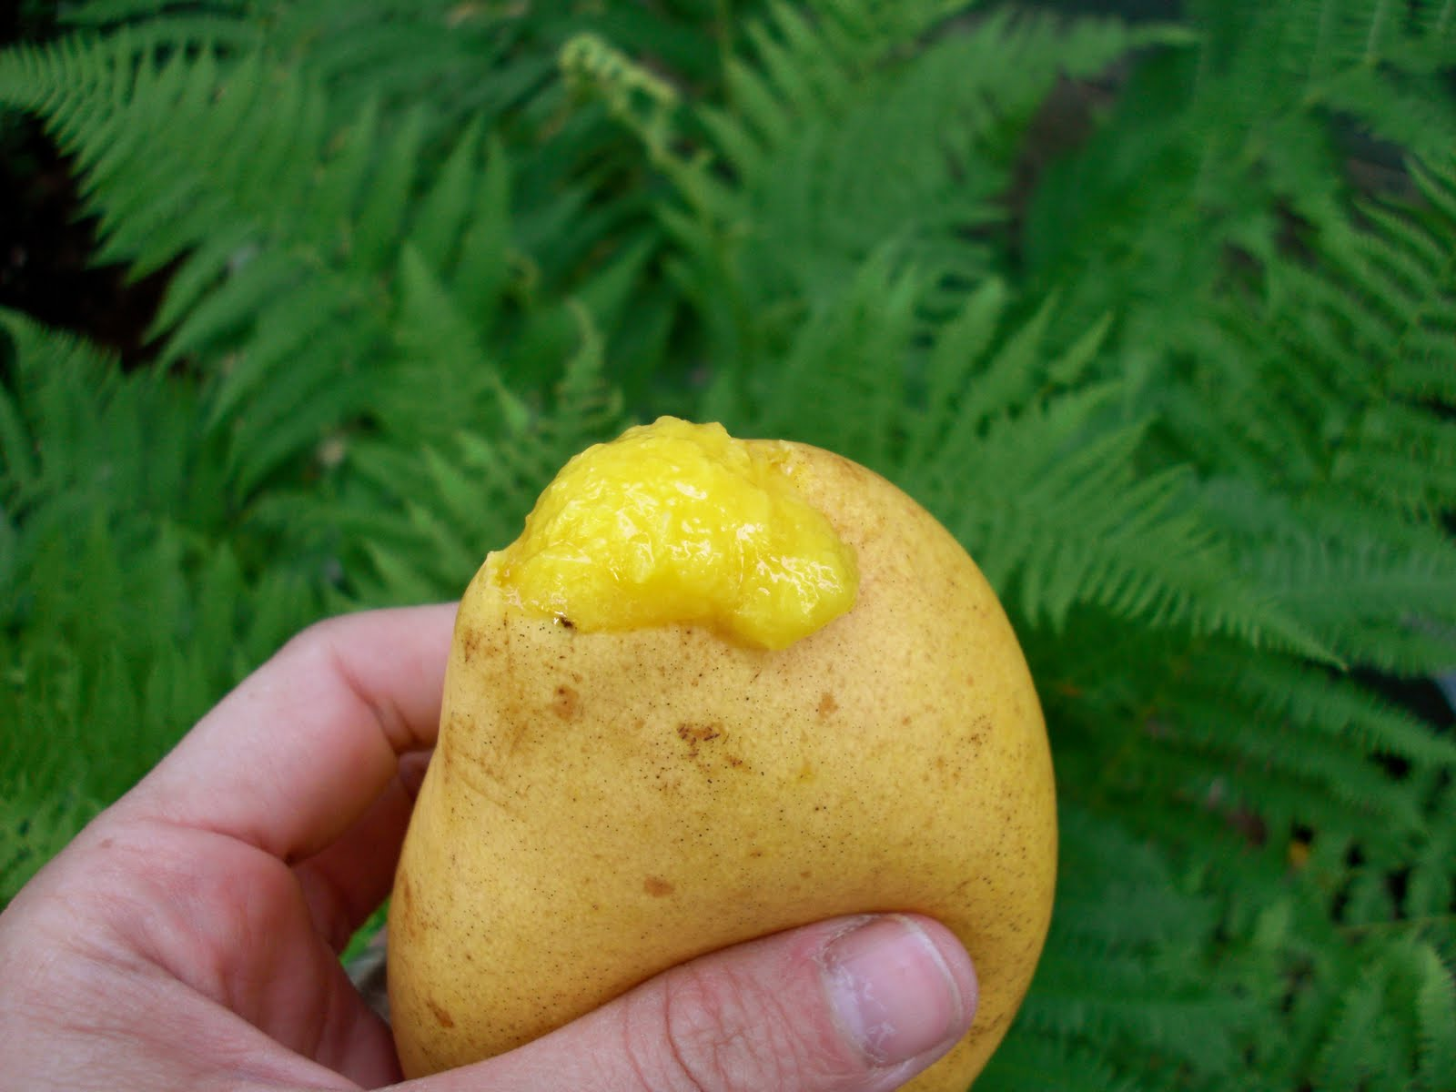
Learning 4
Experience 4: One day your cousin visits you from another city. You decide to treat her with mangoes. But she is like “I don’t care about the sweetness of a mango, I only want the juiciest ones”. Now once again, you run your experiments, tasting all kinds of mangoes, and realizing that the softer ones are juicier.

Slide 26
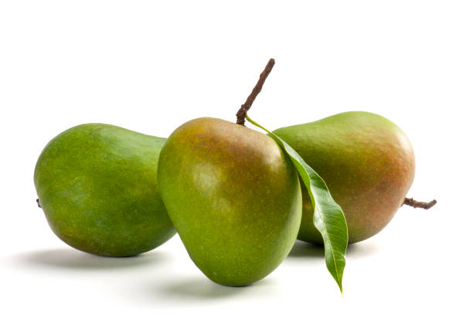
Learning 5
Experience 5: Later on, you move to a different part of the world and you found that the mangoes here taste surprisingly different from your home country. You realized that for this country the green mangoes are tastier than the yellow ones.

Slide 27
Learning 6
Experience 6: You marry someone who hates mangoes but loves apples instead. Now you go for shopping oranges instead of mangoes. Now, all your accumulated knowledge about mangoes is worthless. Now you have to learn everything about the correlation between the physical characteristics and the taste of apples, by the same method of experimentation.

Slide 28
Training and Testing Phase
Machine Learning algorithms are an evolution of normal algorithms. They make your programs “smarter”, by allowing them to automatically learn from the data you provide. The algorithm is mainly divided into:
Training Phase
Testing phase

Slide 29


Training Phase
You take a randomly selected specimen of mangoes from the market (training data), make a table of all the physical characteristics of each mango, like color, size, shape, grown in which part of the country, sold by which vendor, etc (features), along with the sweetness, juiciness, ripeness of that mango (output variables).
You feed this data to the machine learning algorithm (classification/regression), and it learns a model of the correlation between an average mango’s physical characteristics, and its quality.
 | Color | Size | Location | Vendor | Sweetness | Juiciness
Exp1 | Bright Yellow | Any | local | known | Few
Exp2 | Bright Yellow | Bigger | local | Known | 100 % Sweet
 | Bright Yellow | Smaller | local | known | 50% Sweet
Exp3 | Pale Yellow | Smaller | local | unknown | Sweetest
Exp4 | Soft |  |  |  |  | Jucy
Exp5 | Green | Any | Foreign | unknown | Sweetest
Exp6 | Repeat the learning process for Apple

Slide 30

Testing Phase
Next time when you go shopping, you will measure the characteristics of the mangoes which you are purchasing(test data)and feed it to the Machine Learning algorithm.
It will use the model which was computed earlier to predict if the mangoes are sweet, ripe and/or juicy.
Finally, you can now shop for mangoes with great confidence, without worrying about the details of how to choose the best mangoes.

Slide 31
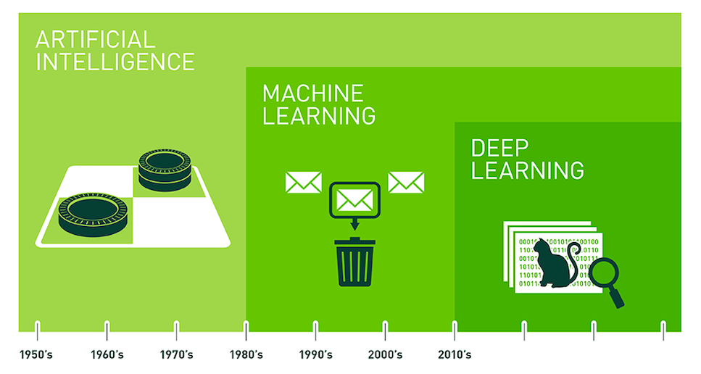
f. AI , ML and DL

Slide 32
g. Open Source Machine Learning Tools

Slide 33
Open Source Tools
OpenAI
TensorFlow
Keras
Charnn
Paddle
CNTK
R
Monte Carlo ML Library
Octave Forge
Scikit Learn
Shogun
Accord.NET Framework
Spark MLlib
H20
Coudera Oryx
GoLearn
Weka
Deep Learn.js
ConvNet.Js

Slide 34
Commercial Tools
Microsoft Azure Machine Learning
SAS Enterprise Miner
IBM SPSS Modeler
RapidMiner
Apache Mahout
MATLAB
Oracle Data Mining

Slide 35
Steps involved in machine learning
Collecting Data
Cleaning Data
Analyze Data
Build Model
Train the Algorithm
Test the Algorithm
Use it

Slide 36
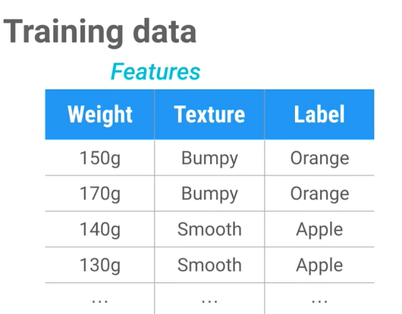
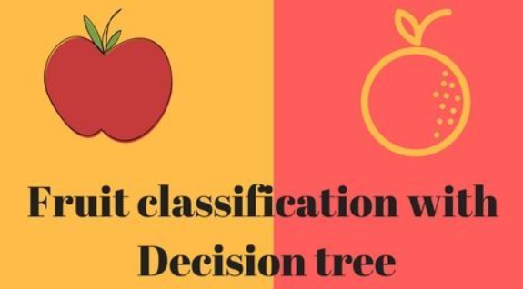
i. Simple Machine Learning Application

Slide 37
https://github.com/profthyagu

Slide 38
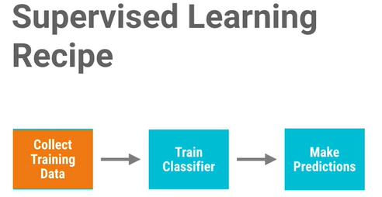

Slide 39
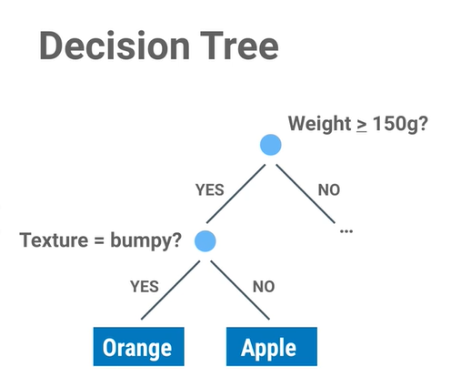
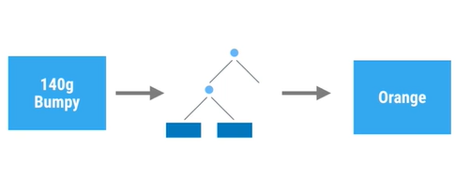

Slide 40
Hands On

Slide 41
End of Day1 Part1

Slide 42
2 .Data Preprocessing

Slide 43
Data Sets
A data set (or dataset) is a collection of data/examples/experiences in the from of database table or data matrix.
Column represents attributes/ target attributes .
Row corresponds to a given member of the data set in question (each experience or examples)
Each value is known as a datum.

Slide 44
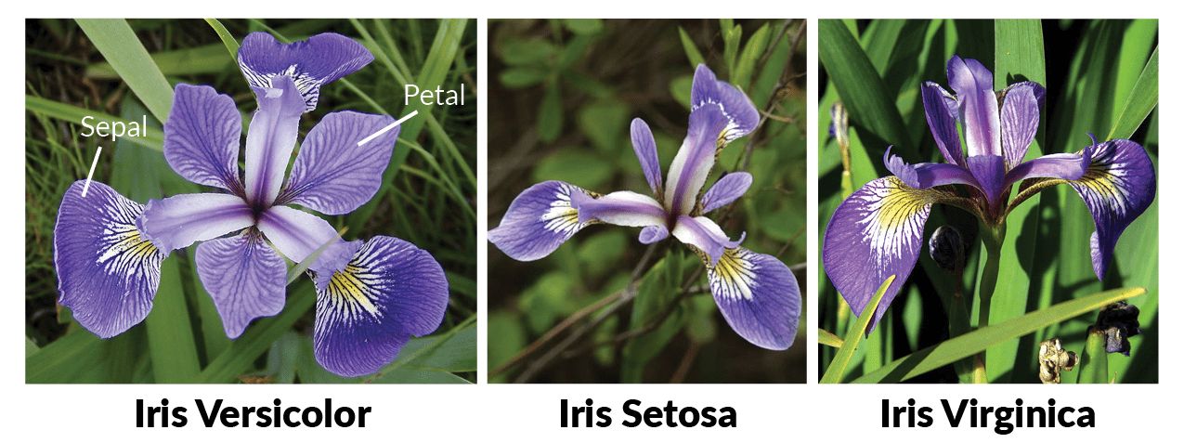

Slide 45
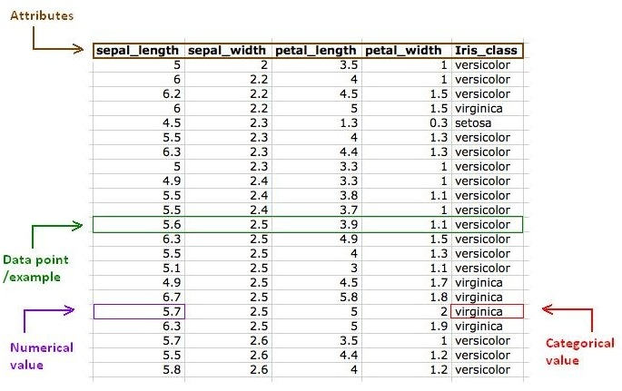
Target Attribute

Slide 46
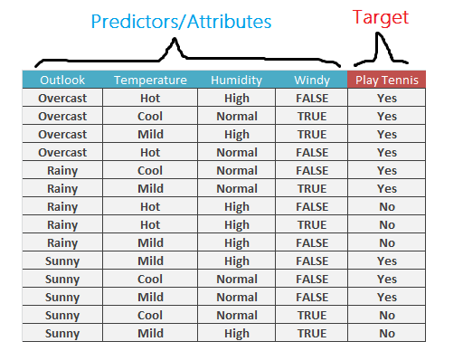

Slide 47
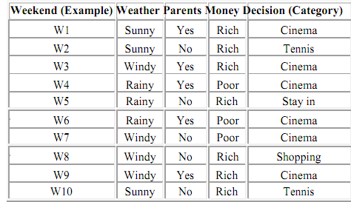

Slide 48
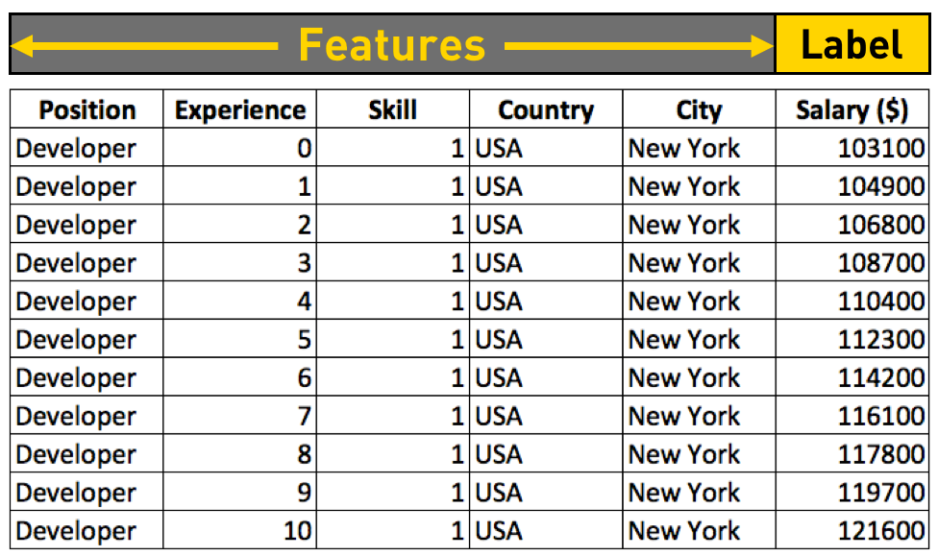

Slide 49
Classic Data Sets Examples

Slide 50
Example1 : IRIS Data Set
The Iris flower data set or Fisher's Iris data set is a multivariate data set introduced by the British statistician and biologist Ronald Fisher in his 1936 paper .
The data set consists of 50 samples from each of three species (150) of Iris (Iris setosa, Iris virginica and Iris versicolor). Four features were measured from each sample: the length and the width of the sepals and petals, in centimeters.

Slide 51
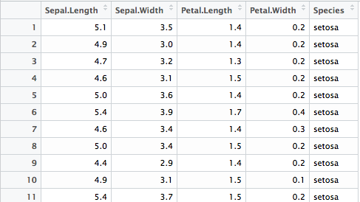

Slide 52
Example2 : MNSIT DATABASE
The MNIST database (Modified National Institute of Standards and Technology database) is a large database of handwritten digits that is commonly used for training various image processing systems.
The MNIST database contains 60,000 training images and 10,000 testing images.

Slide 53


Slide 54
Example 3: HOUSE PRICE DATA SET
Variables in order:
CRIM per capita crime rate by town
ZN proportion of residential land zoned for lots over 25,000 sq.ft.
INDUS proportion of non-retail business acres per town
CHAS Charles River dummy variable (= 1 if tract bounds river; 0 otherwise)
NOX nitric oxides concentration (parts per 10 million)
RM average number of rooms per dwelling
AGE proportion of owner-occupied units built prior to 1940
DIS weighted distances to five Boston employment centres
RAD index of accessibility to radial highways
TAX full-value property-tax rate per $10,000
PTRATIO pupil-teacher ratio by town B 1000(Bk - 0.63)^2 where Bk is the proportion of blacks by town
LSTAT % lower status of the population
MEDV Median value of owner-occupied homes in $1000's

Slide 55
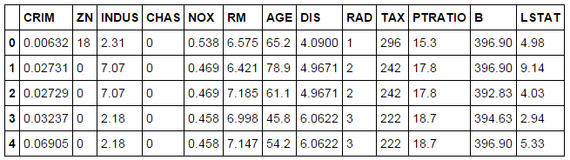

Slide 56
Example 4: Diabetes Data Set
This dataset is originally from the National Institute of Diabetes and Digestive and Kidney Diseases. The objective of the dataset is to diagnostically predict whether or not a patient has diabetes, based on certain diagnostic measurements included in the dataset. Several constraints were placed on the selection of these instances from a larger database. In particular, all patients here are females at least 21 years old of Pima Indian heritage.
The datasets consists of several medical predictor variables and one target variable, Outcome. Predictor variables includes the number of pregnancies the patient has had, their BMI, insulin level, age, and so on

Slide 57
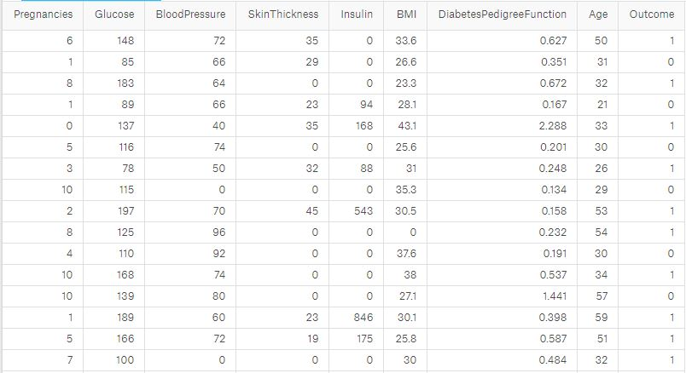

Slide 58
Example5: Wine Data Set
This data set is the result of a chemical analysis of wines grown in the same region in Italy but derived from three different cultivars. The analysis determined the quantities of 13 constituents found in each of the three types of wines"
Labels: "name" - Number denoting a specific wine class
Number of instances of each wine class : Class 1 – 59 , Class 2 – 71 , Class 3 – 48 ,
Features: Alcohol , Malic acid , Ash , Alcalinity of ash , Magnesium, Total phenols , Flavanoids , Nonflavanoid phenols , Proanthocyanins , Color intensity , Hue , OD280/OD315 of diluted wines, Proline

Slide 59
Example 6: Breast Cancer (Diagnostic) Data Set
Features are computed from a digitized image of a fine needle aspirate (FNA) of a breast mass. They describe characteristics of the cell nuclei present in the image.
Attribute Information:
1) ID number 2) Diagnosis (M = malignant, B = benign)
Ten real-valued features are computed for each cell nucleus:
a) radius (mean of distances from center to points on the perimeter)
b) texture (standard deviation of gray-scale values)
c) perimeter d) area e) smoothness (local variation in radius lengths) f) compactness (perimeter^2 / area - 1.0) g) concavity (severity of concave portions of the contour) h) concave points (number of concave portions of the contour) i) symmetry j) fractal dimension ("coastline approximation" - 1)

Slide 60
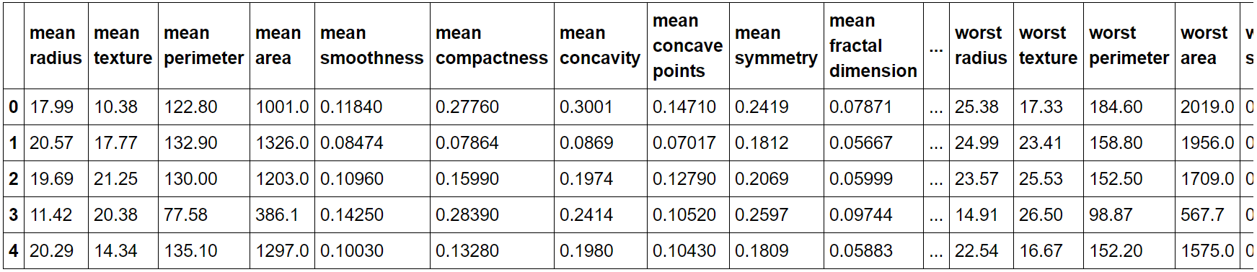

Slide 61
Types of Data
Raw Data
Structured Data
Unstructured Data

Slide 62
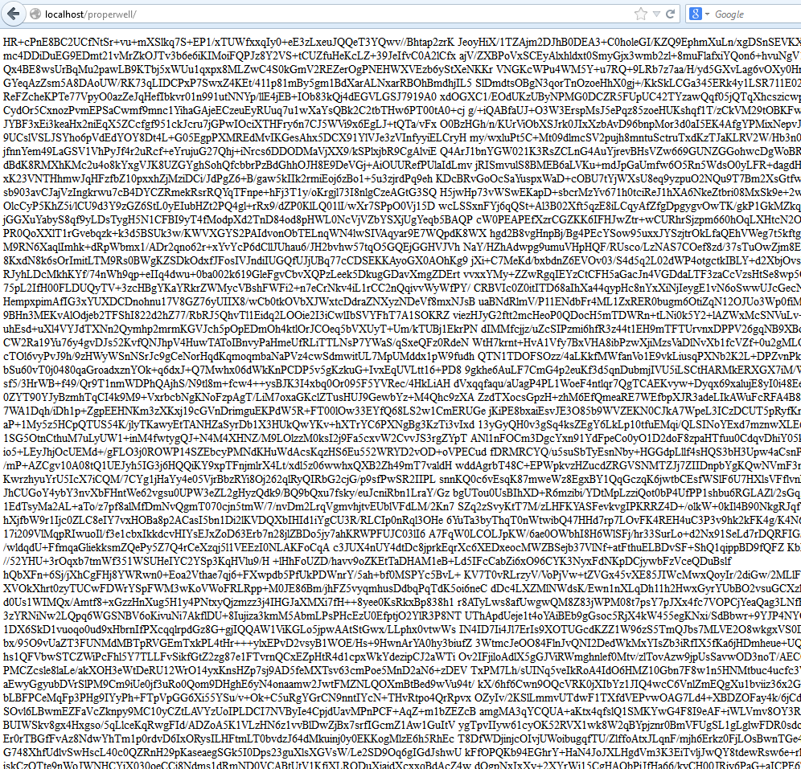
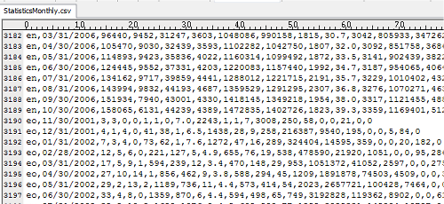
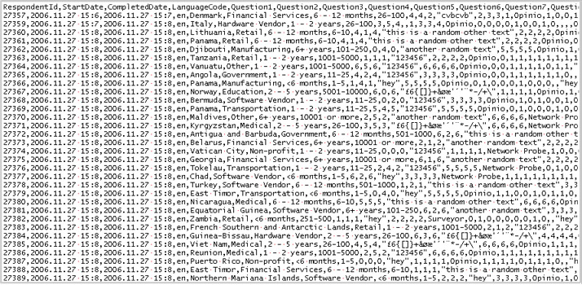

Slide 63
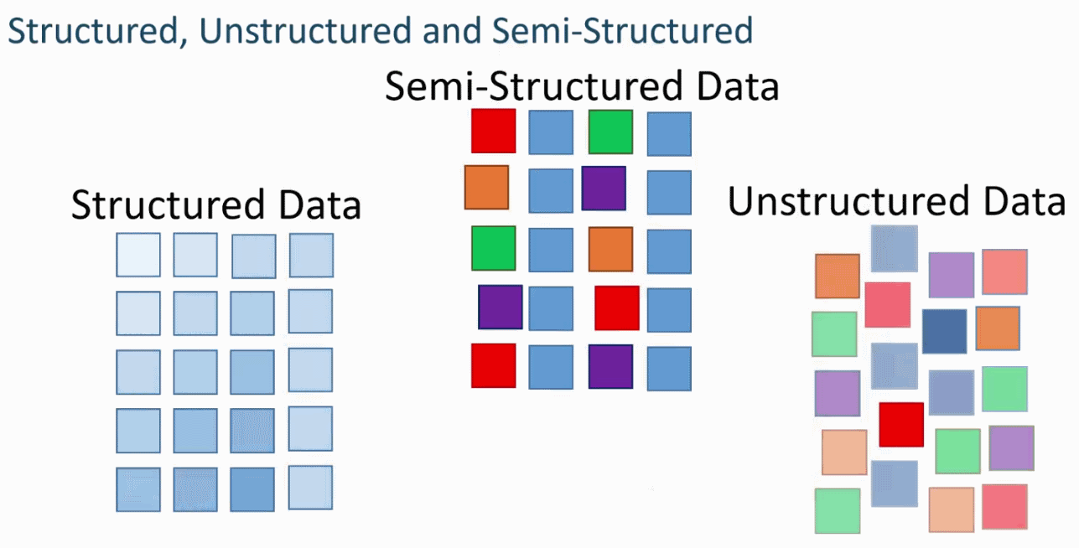

Slide 64
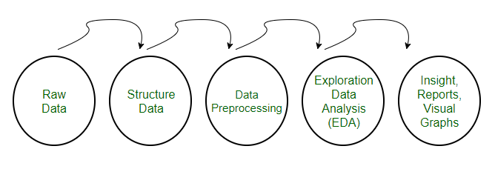
Data Preprocessing for Machine learning in Python
Pre-processing refers to the transformations applied to our data before feeding it to the algorithm.
Data Preprocessing is a technique that is used to convert the raw data into a clean data set. In other words, whenever the data is gathered from different sources it is collected in raw format which is not feasible for the analysis.

Slide 65
Need of Data Preprocessing
For achieving better results from the applied model in Machine Learning projects the format of the data has to be in a proper manner.
Some specified Machine Learning model needs information in a specified format, for example, Random Forest algorithm does not support null values, therefore to execute random forest algorithm null values have to be managed from the original raw data set.
Another aspect is that data set should be formatted in such a way that more than one Machine Learning and Deep Learning algorithms are executed in one data set, and best out of them is chosen.

Slide 66
Major Tasks in Data Preprocessing
Data cleaning
Fill in missing values, smooth noisy data, identify or remove outliers, and resolve inconsistencies
Data integration
Integration of multiple databases, data cubes, or files
Data reduction
Dimensionality reduction
Numerosity reduction
Data compression
Data transformation and data discretization
Normalization
Concept hierarchy generation

Slide 67
Data Cleaning
Data in the Real World Is Dirty: Lots of potentially incorrect data, e.g., instrument faulty, human or computer error, transmission error
Incomplete(missing): lacking attribute values, lacking certain attributes of interest, or containing only aggregate data
e.g., Occupation=“ ” (missing data)
noisy: containing noise, errors, or outliers
e.g., Salary=“−10” (an error)
inconsistent: containing discrepancies in codes or names, e.g.,
Age=“42”, Birthday=“03/07/2010”
Was rating “1, 2, 3”, now rating “A, B, C”
discrepancy between duplicate records
Intentional (e.g., disguised missing data)
Jan. 1 as everyone’s birthday?

Slide 68
Incomplete (Missing) Data
Data is not always available
E.g., many tuples have no recorded value for several attributes, such as customer income in sales data
Missing data may be due to
equipment malfunction
inconsistent with other recorded data and thus deleted
data not entered due to misunderstanding
certain data may not be considered important at the time of entry
not register history or changes of the data
Missing data may need to be inferred

Slide 69
How to Handle Missing Data?
Ignore the tuple: usually done when class label is missing (when doing classification)—not effective when the % of missing values per attribute varies considerably
Fill in the missing value manually: tedious + infeasible?
Fill in it automatically with
a global constant : e.g., “unknown”, a new class?!
the attribute mean
the attribute mean for all samples belonging to the same class: smarter
the most probable value: inference-based such as Bayesian formula or decision tree

Slide 70
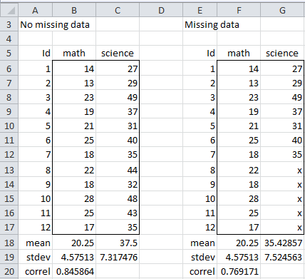
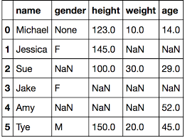

Slide 71
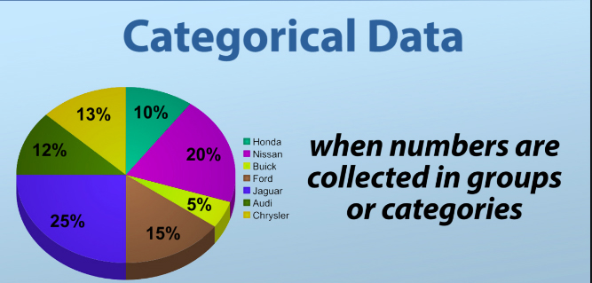
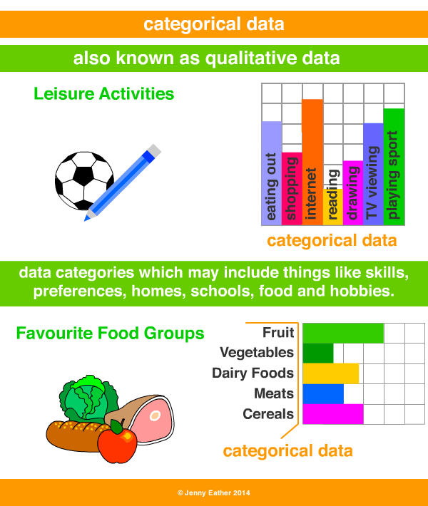
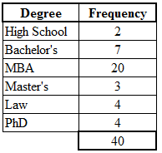

Slide 72
Noisy Data
Noise: random error or variance in a measured variable
Incorrect attribute values may be due to
faulty data collection instruments
data entry problems
data transmission problems
technology limitation
inconsistency in naming convention
Other data problems which require data cleaning
duplicate records
incomplete data
inconsistent data
72
Notes:
72

Slide 73
Preprocessing the Data in Python
In our daily life, we deal with lots of data but this data is in raw form. To provide the data as the input of machine learning algorithms, we need to convert it into a meaningful data.
That is where data preprocessing comes into picture. In other simple words, we can say that before providing the data to the machine learning algorithms we need to preprocess the data.

Slide 74
Training , Testing and Validation Data set
Training Dataset: A set of examples used for learning, that is to fit the parameters [i.e., weights] of the classifier or model.
Validation Dataset: The sample of data used to provide an unbiased evaluation of a model fit on the training dataset while tuning model hyperparameters. A set of examples used to tune the parameters [i.e., architecture, not weights] of a classifier, for example to choose the number of hidden units in a neural network.
Test Dataset: The sample of data used to provide an unbiased evaluation of a final model fit on the training dataset. A set of examples used only to assess the performance [generalization] of a fully specified classifier.

Slide 75
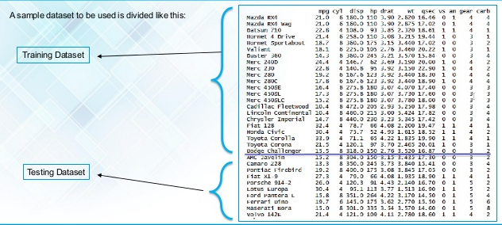

Slide 76
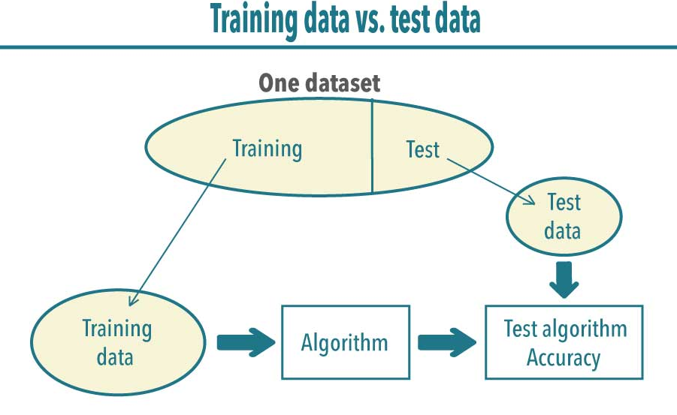

Slide 77
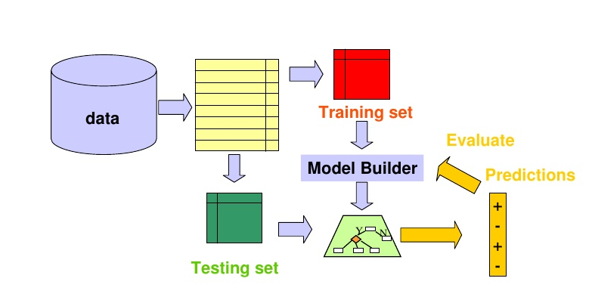

Slide 78
Data preprocessing steps
Step 1 − Importing the useful packages
Step 2 − Defining sample data
Step3 − Applying preprocessing technique

Slide 79
Step 1 − Importing the useful packages
If we are using Python then this would be the first step for converting the data into a certain format, i.e., preprocessing. It can be done as follows −
import numpy as np
from sklearn import preprocessing
Here we have used the following two packages −
NumPy − Basically NumPy is a general purpose array-processing package designed to efficiently manipulate large multi-dimensional arrays of arbitrary records without sacrificing too much speed for small multi-dimensional arrays.
sklearn.preprocessing − This package provides many common utility functions and transformer classes to change raw feature vectors into a representation that is more suitable for machine learning algorithms.
proftgs.blogspot.com

Slide 80
Step 2 − Defining sample data
After importing the packages, we need to define some sample data so that we can apply preprocessing techniques on that data.
We will now define the following sample data −
input_data = np.array([2.1, -1.9, 5.5],
[-1.5, 2.4, 3.5],
[0.5, -7.9, 5.6],
[5.9, 2.3, -5.8 ]])

Slide 81
Step3 − Applying preprocessing technique
In this step, we need to apply any of the preprocessing techniques.

Slide 82
Techniques for Data Preprocessing
Scaling /Rescaling : # Min max scaling
Standardization
Normalization
L1 Normalization
L2 Normalization
Binarization
Mean Removal
Labeling the Data

Slide 83
1. Scaling or Rescaling Data
When your data is comprised of attributes with varying scales, many machine learning algorithms can benefit from rescaling the attributes to all have the same scale.
The attributes are often rescaled into the range between 0 and 1.
You can rescale data using scikit-learn using the MinMaxScaler class.

Slide 84
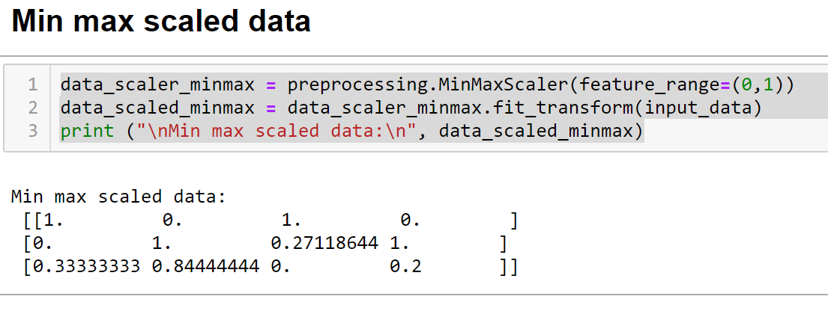
Example : Min max scaled data

Slide 85
2 . Standardize Data
Standardization is a useful technique to transform attributes with a Gaussian distribution and differing means and standard deviations to a standard Gaussian distribution with a mean of 0 and a standard deviation of 1.
You can standardize data using scikit-learn with the StandardScaler class.

Slide 86
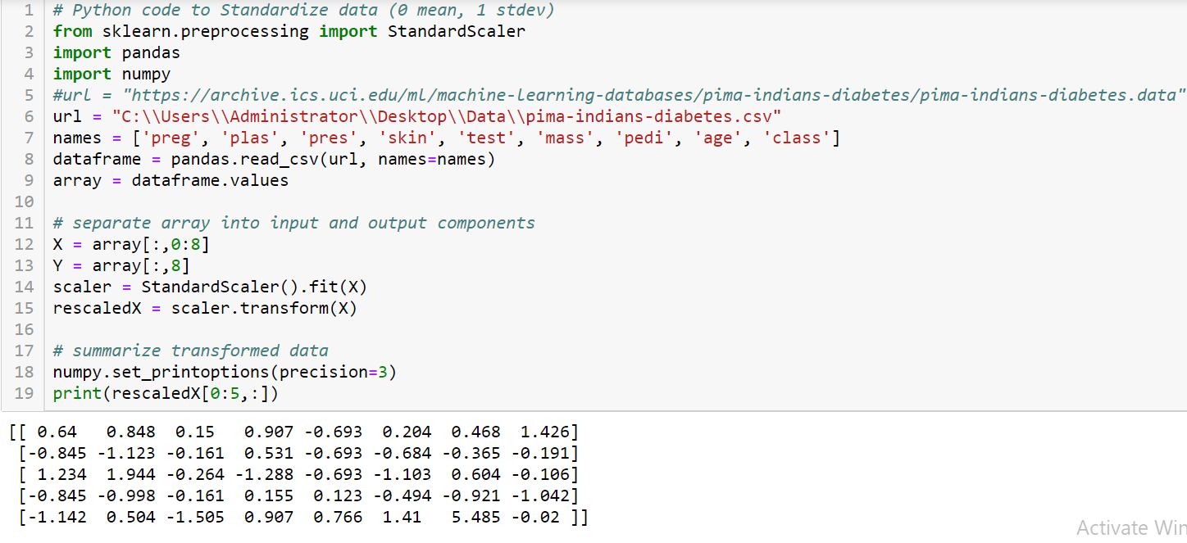

Slide 87
3. Normalization
Normalizing in scikit-learn refers to rescaling each observation (row) to have a length of 1 (called a unit norm in linear algebra).
You can normalize data in Python with scikit-learn using the Normalizer class.
It is another data preprocessing technique that is used to modify the feature vectors. Such kind of modification is necessary to measure the feature vectors on a common scale.
Followings are two types of normalization which can be used in machine learning −

Slide 88

L1 Normalization
It is also referred to as Least Absolute Deviations. This kind of normalization modifies the values so that the sum of the absolute values is always up to 1 in each row. It can be implemented on the input data with the help of the following Python code −

Slide 89

L2 Normalization
It is also referred to as least squares. This kind of normalization modifies the values so that the sum of the squares is always up to 1 in each row.
It can be implemented on the input data with the help of the following Python code −

Slide 90


Slide 91

4.Binarization
You can transform your data using a binary threshold. All values above the threshold are marked 1 and all equal to or below are marked as 0.
This is called binarizing your data or threshold your data
You can create new binary attributes in Python using scikit-learn with the Binarizer class.

Slide 92

5. Mean Removal
It is another very common preprocessing technique that is used in machine learning. Basically it is used to eliminate the mean from feature vector so that every feature is centered on zero.
We can also remove the bias from the features in the feature vector. For applying mean removal preprocessing technique on the sample data, we can write the Python code shown below.

Slide 93
6. Labelling the Data
We already know that data in a certain format is necessary for machine learning algorithms.
Another important requirement is that the data must be labelled properly before sending it as the input of machine learning algorithms.
The process of transforming the word labels into numerical form is called label encoding.

Slide 94
Label encoding steps
Step 1 − Importing the useful packages
Step 2 − Defining sample labels
Step 3 − Creating & training of label encoder object
Step 4 − Checking the performance by encoding random ordered list
Step 5 − Checking the performance by decoding a random set of numbers −

Slide 95


Slide 96


Slide 97


Slide 98


Slide 99
Hands on

